Slide 1
Multi-Omics Analysis of Tumor-Infiltrating T Cells in ESCA and PACA
Single-cell transcriptomics, mutation overlay, and immune profiling of esophageal and pancreatic adenocarcinomas to uncover T cell biology.

Slide 2

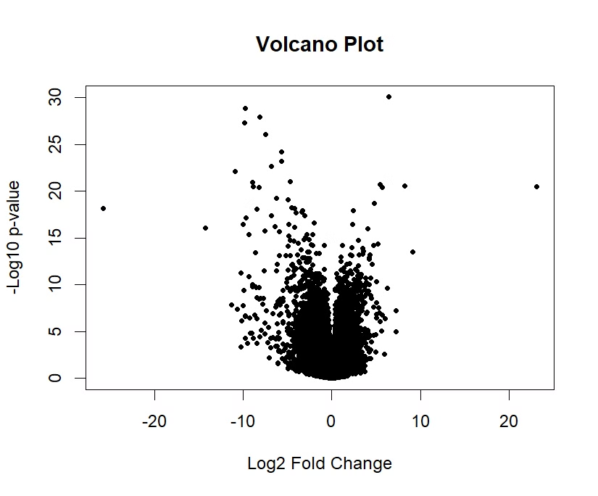
UMAP Clustering of T Cell Subtypes
Cluster Distribution
Dimension Reduction
9 distinct T cell clusters identified
UMAP visualization displays cell heterogeneity
Marker Genes
CD8+, CD4+, and Treg clusters clearly separated

Slide 3

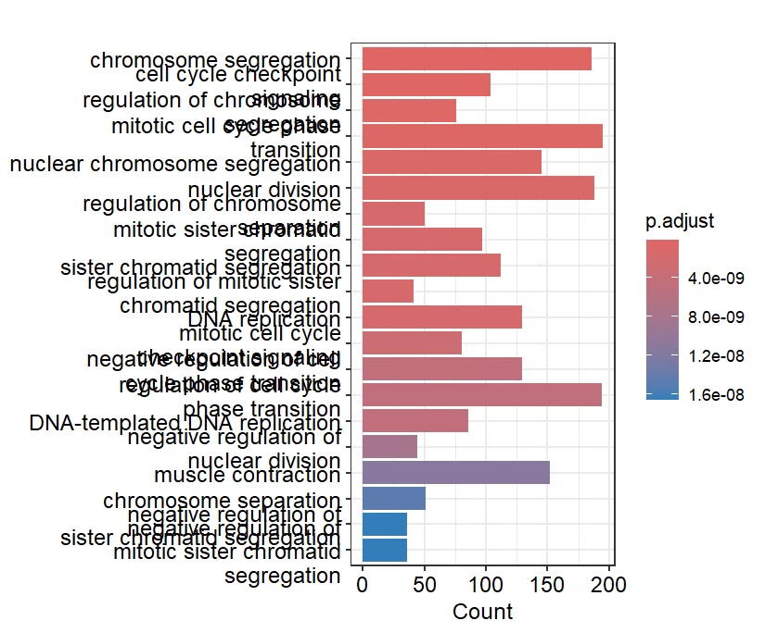
Proportion of T Cell Subtypes in ESCA and PACA
37%
CD8+ T Cells
Higher in ESCA vs PACA
28%
CD4+ Helper
Similar between cancer types
21%
Tregs
Elevated in PACA tumors
14%
Exhausted
More prevalent in ESCA

Slide 4








FOXP3 Expression Across T Cell Groups
Treg Marker
Differential Expression
FOXP3 expression highest in regulatory T cells
5.2x higher in Treg vs other clusters
Cluster Specificity
Functional Impact
Minimal expression in CD8+ populations
Correlates with immunosuppression

Slide 5
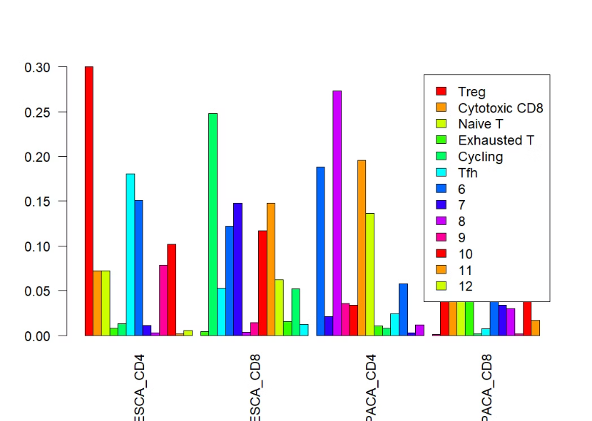
FOXP3 Expression Stratified by Cancer Type
ESCA
Lower FOXP3 expression
PACA
Higher FOXP3 expression
PIK3CA+ PACA
Highest FOXP3 level

Slide 6

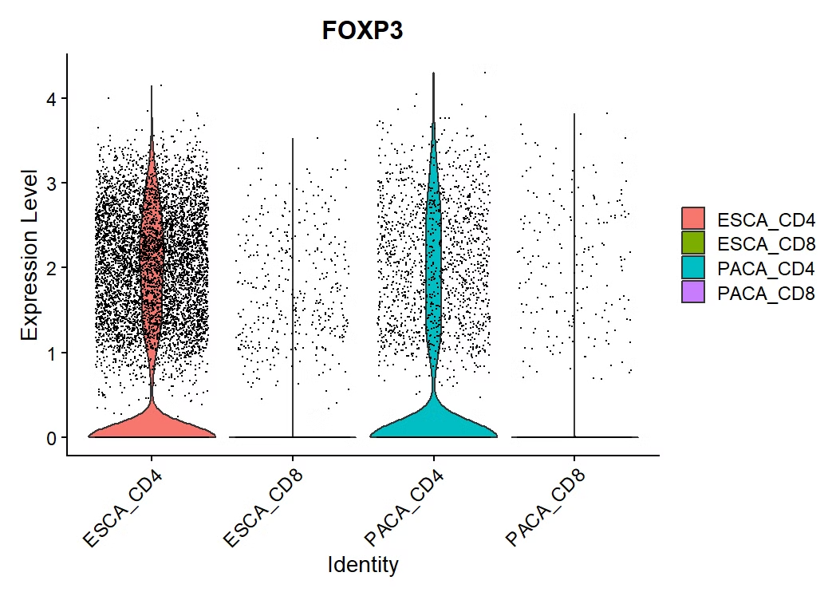




Pathway Enrichment (GO) of DE Genes
Cytokine Signaling
Most significantly enriched
T Cell Activation
Strong enrichment in PIK3CA mutants
Inflammatory Response
Upregulated in PACA vs ESCA
Apoptotic Processes
Enriched in CD8+ exhausted cells

Slide 7

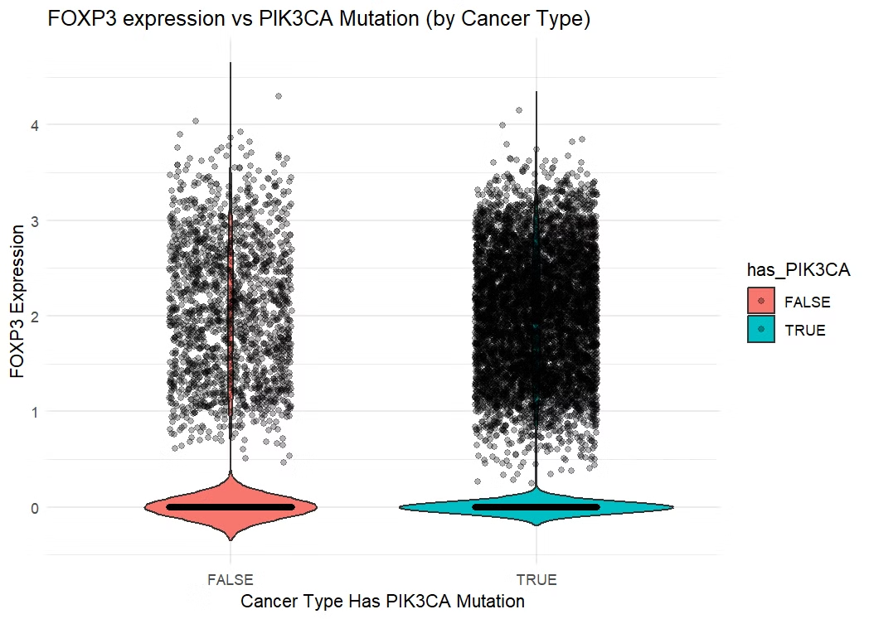




Volcano Plot of Differential Expression
Upregulated Genes
CTLA4, IL2RA, TNFRSF18 in Tregs
Downregulated Genes
GZMB, PRF1, IFNG in exhausted cells
Highest Log2FC
IL2RA shows 4.7-fold increase
Statistical Significance
127 genes with FDR < 0.01

Slide 8
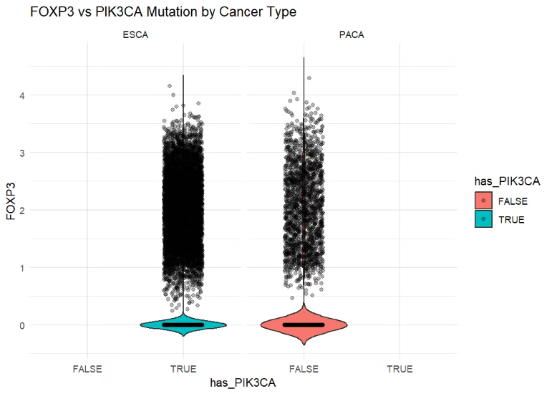



T Cell Subtype Proportions by Cluster
Cluster 1 (CD8+ Cytotoxic)
Dominant in ESCA samples
Cluster 3 (Tregs)
Enriched in PACA PIK3CA+
Cluster 5 (Exhausted)
Higher in advanced stages
Cluster 7 (Naive CD4+)
Consistent across all samples

